Slide 1
ALGORITHM
A finite set of instructions which if followed accomplish a particular task.
In addition every algorithm must satisfy following criteria:

Slide 2
ALGORITHM
Input: zero or more quantities externally supplied
Output: at least one quantity is produced
3. Definiteness: Each instruction must be clear and unambiguous.
4. Finiteness: In all cases algorithm must terminate after finite number of steps.
5. Effectiveness: n0 unnecessary statement

Slide 3
Efficiency of an Algorithm
Some questions to answer:
How fast can we solve a problem?
How much space is required ?
There may be many algorithms for a given problem. Which algorithm to use?

Slide 4
Efficiency of an Algorithm
Two measures
Time
Space
A good algorithm is like a sharp knife, it does exactly what it is supposed to do with a minimum amount of effort.

Slide 5
Complexity of an algorithm
The complexity of an algorithm M is the function f(n) which gives the running time and/or space in terms of the input size n
or
Complexity shall refer to the running time of an algorithm

Slide 6
Complexity of an algorithm
Assume that a simple statement takes 1 time unit
x=5*a+6*b
time complexity, is 1 unit time
Space complexity
a→ 1 word
b→ 1 word
x→ 1 word
Space complexity is 3 words

Slide 7
Time Complexity of an algorithm
To analyze the real time complexity of a program we need to determine two numbers for each statement in it:
amount of time a single statement will take.
No. of times it is executed.
Product of these two, will be the total time taken by the statement.

Slide 8
Time Complexity of an algorithm
First no. depends upon the machine and compiler used , hence the real time complexity is machine dependent.

Slide 9
Time Complexity of an algorithm
Frequency count method
To make analysis machine independent it is assumed that every instruction takes the same constant amount of time for execution.
Hence the determination of time complexity of a program is the matter of summing the frequency counts of all the statements.

Slide 10
Time Complexity of an algorithm
Frequency
Sum(A,n)
{ s=0;
for(i=0;i<n;i++)
{ s=s+A[i];
}
return s;
}
1
n+1
n
1
f(n)=2n+3

Slide 11
Time Complexity
Add (A,B,n)
{
for(i=0;i<n;i++) {
for(j=0;j<n;j++) {
c[i,j]=A[i,j]+B[i,j]; }
}
}
Frequency
n+1
n x (n+1)
n x n
f(n)= 2n²+2n+1

Slide 12
Analysis of an algorithm
Worst case
The maximum value of f(n) for any possible input
Average case:
The expected value of f(n)
Best case
The minimum possible value of f(n)

Slide 13
Asymptotic Analysis
a measure of efficiency of algorithms
Asymptotic notations are mathematical tools to represent time complexity of algorithms for asymptotic analysis.
is a method of describing limiting behavior

Slide 14
Asymptotic Analysis
Suppose that we are interested in the properties of a function f(n) as n becomes very large.
If f(n) = n² + 3n, then as n becomes very large, the term 3n becomes insignificant compared to n². The function f(n) is said to be "asymptotically equivalent to n², as n → ∞“
The following 3 asymptotic notations are mostly used to represent time complexity of algorithms:

Slide 15
Asymptotic Notations
Big O or Oh Notation (O)
Big Omega Notation(Ω)
Big Theta Notation(Θ)

Slide 16
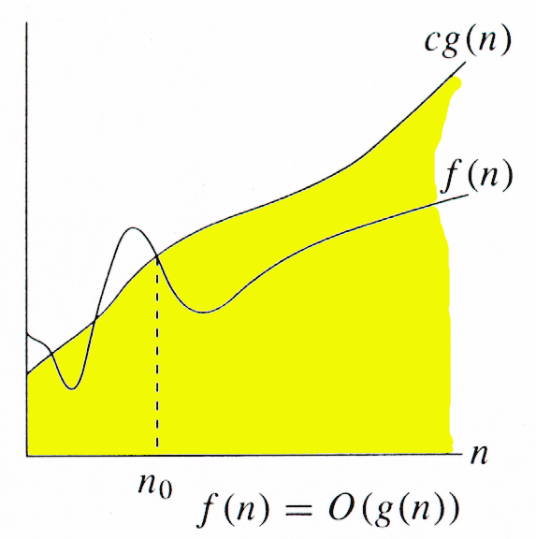
Big O Notation
For function g(n), O(g(n)) is given by:
O(g(n)) = {f(n): ∃ +ve constants
c and n₀ such that 0 ≤ f(n) ≤ cg(n),
∀n ≥ n₀ }
Intuitively: Set of all functions
whose rate of growth is the same as
or lower than that of g(n).
g(n) is an asymptotic upper bound for f(n).

Slide 17
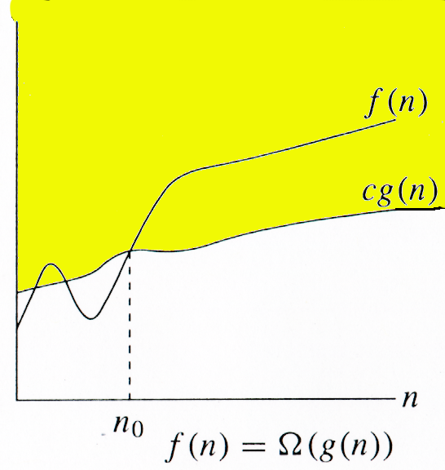
Ω Notation
For function g(n), Ω(g(n)) is given by:
Ω(g(n)) = {f(n): ∃ +ve constants c
and n₀ such that 0 ≤ cg(n) ≤ f(n),
∀n ≥ n₀ }
Intuitively: Set of all functions whose
rate of growth is the same as or higher
than that of g(n).
g(n) is an asymptotic lower bound for f(n).

Slide 18
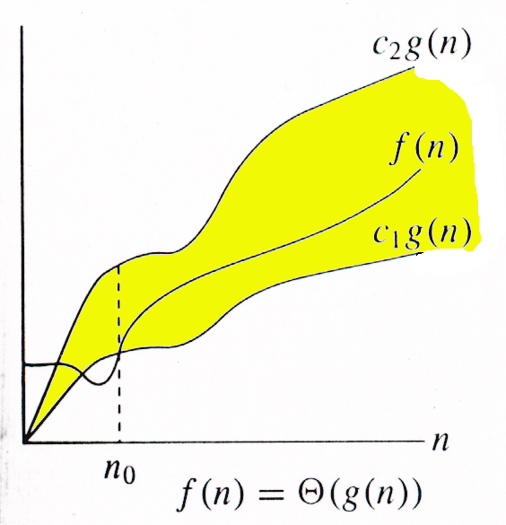
Θ-notation
For function g(n), Θ(g(n))
is given by:
Θ(g(n)) = {f(n): ∃ +ve constants
c₁, c₂ and n₀ such that
0 ≤ c₁g(n) ≤ f(n) ≤ c₂g(n),∀n ≥ n₀ }
Intuitively: Set of all functions
that have the same rate of growth
as g(n).
g(n) is an asymptotically tight bound for f(n)

Slide 19
Asymptotic Notations

Slide 20
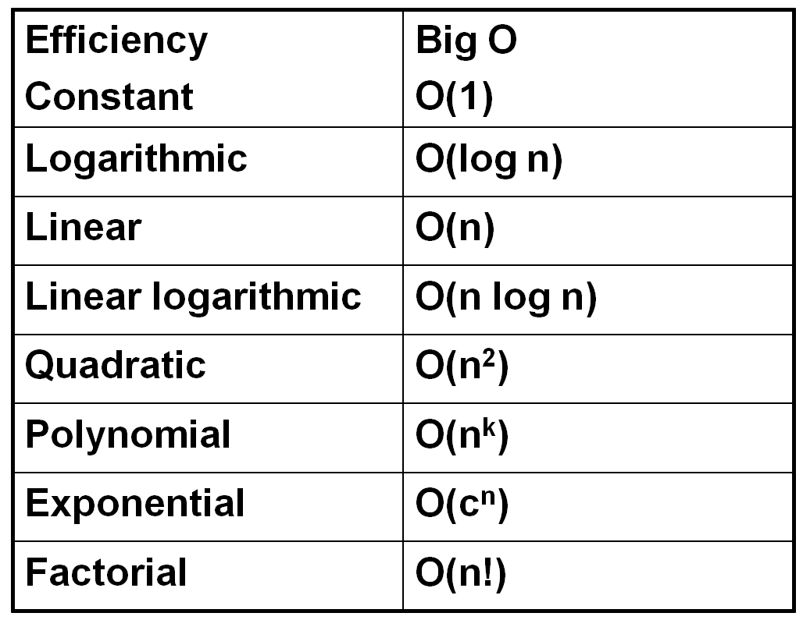
Categories of algorithm efficiency

Slide 21
Excersise
Reorder the following complexity from smallest to largest:
n log₂(n)
n + n² + n³
2⁴
√n
Answer :
(a) 2⁴
(b) √n
(c) n log₂(n)
(d) n + n² + n³

Slide 22
Time complexity
f(n)=2n+3
=> O(n)
f(n)=O(n²)
f(n) =O(2^{n})
All are correct , but we choose the closer one which is f(n)=O(n)

Slide 23
Time complexity
f(n)= 2n+3
=>Ω(n)
f(n)= Ω(log n) √
f(n)= Ω(n² ) X
But nearest one is useful i.e. f(n)=Ω(n)

Slide 24
Time complexity
f(n)=2n+3
=>Θ(n)
It is tight bound so it can only take one value

Slide 25
Time Space Trade-off
There is usually a trade-off between optimal memory use and runtime performance.
Space efficiency and time efficiency reach at two opposite ends and each point in between them has a certain time and space efficiency. So, the more time efficiency you have, the less space efficiency you have and vice versa.
Eg. Mergesort algorithm is exceedingly fast but requires a lot of space to do the operations. On the other side, Bubble Sort is exceedingly slow but requires the minimum space.

Slide 26
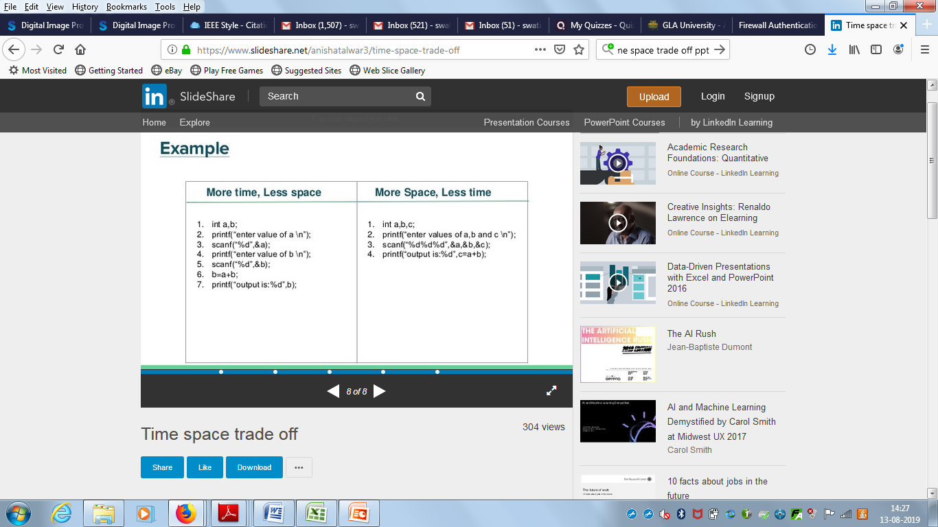
Time Space Trade-off

